Slide 1

ENPM 809Y Final Project Presentation - Spring 2019
Group Members: Arun Kumar Devarajulu Zuyang Cao
Qidi Xu
Hongyang Jiang
Notes:
overall architecture of your project, C++ classes and other C++ structures in an UML format. Talk about the A* you implemented and how it is integrated in the project (using diagrams for instance). I want names of people in the group appearing in the slides and which part of the project they contributed to.

Slide 2
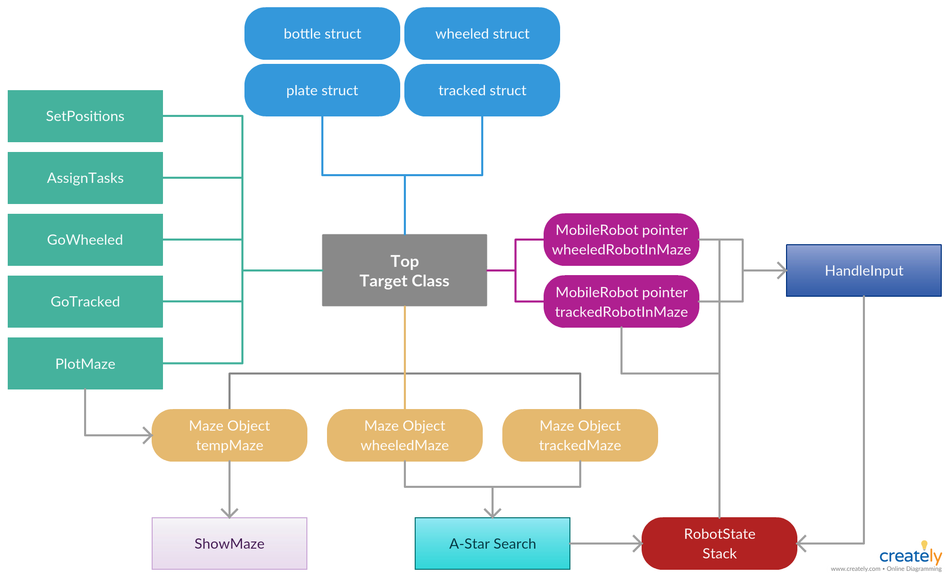
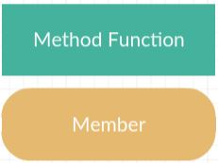
Overall Sturctue
All members are private members.
Sample:
Notes:
overall architecture of your project

Slide 3
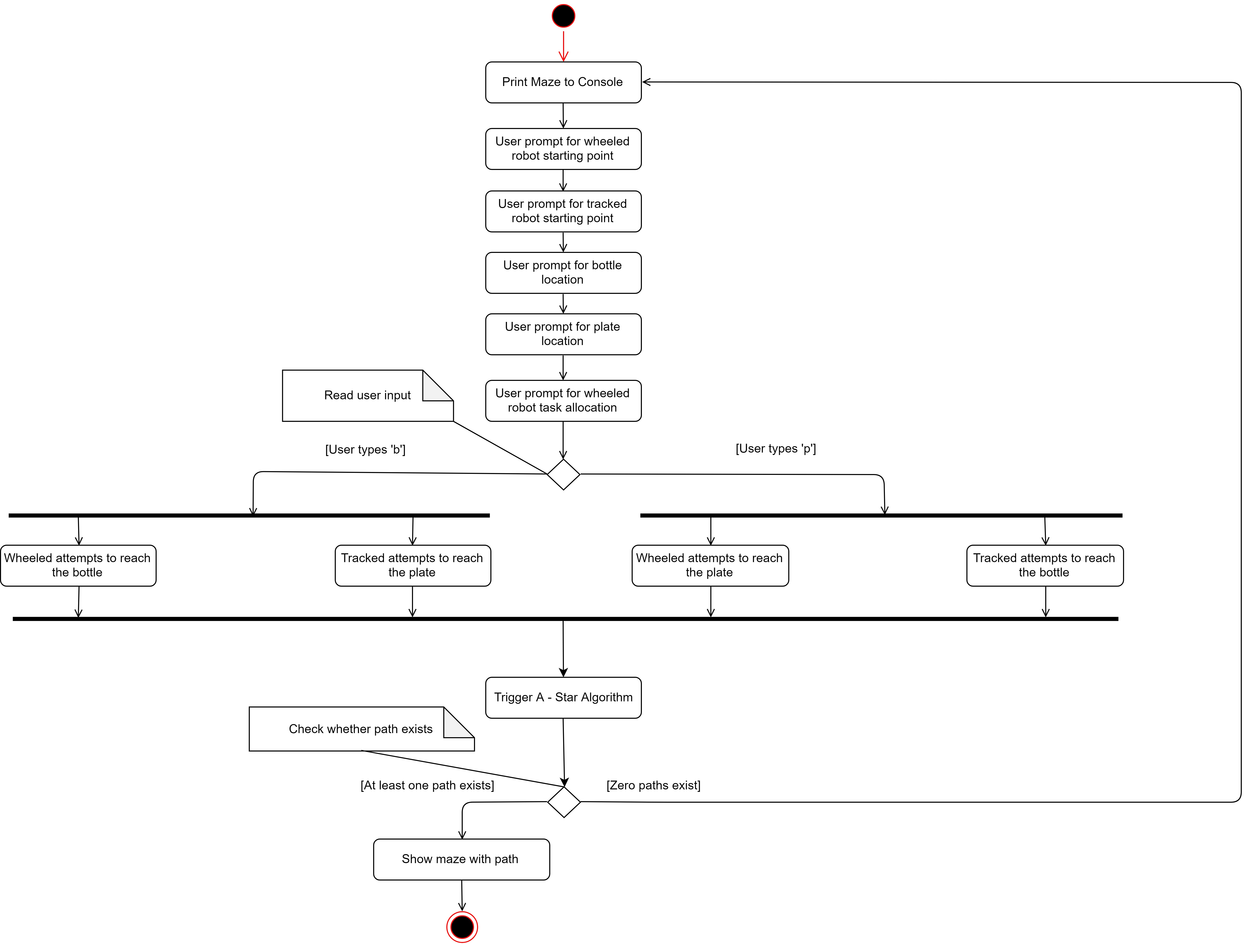
Overall Architecture
Target.h
Notes:
overall architecture of your project

Slide 4
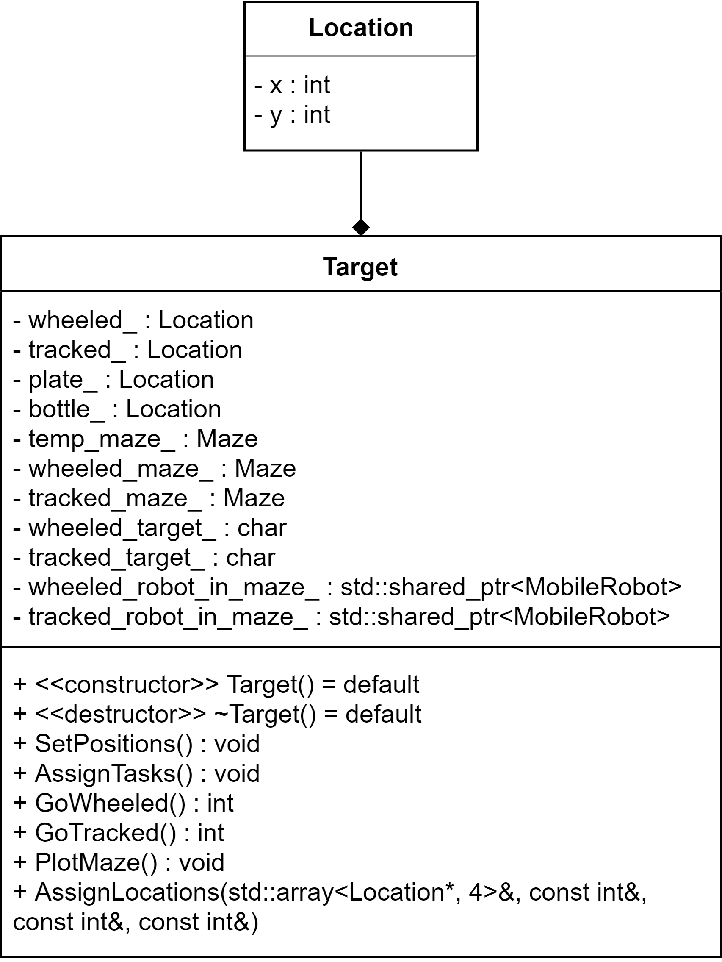

Target.h
Contributor: Zuyang Cao
Target Class
Target Class is the top class in the program, it is like the machine city in Matrix, taking care of every sub-functions and classes and merge everything together. It use every sub-functions and other classes to build the whole program and keep them running correctly, just like the machine city does.
Image from https://scifi.stackexchange.com/questions/146742/did-the-zionese-ever-take-the-fight-to-the-machines
Notes:
C++ classes

Slide 5
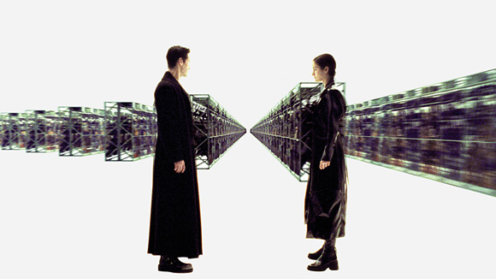
Robot Classes and State Classes
Robot classes and State classes are basic classes that provides objects running through Maze class and Target class, doing their specific jobs in finite state machine.
They are like digital guns in Matrix. They are necessary tools, but they need others to use them so that they can do their jobs.
Also, tools can be used by others, that’s why we create them as classes not just some sub-functions and variables. Being classes, they can easily be used in other occasions and programs (instead of being used by its creator, machine city, it can also be used by Neo.).
Image from https://gamingballistic.com/2015/06/28/violent-resolution-guns-lots-of-guns/
Notes:
C++ classes

Slide 6
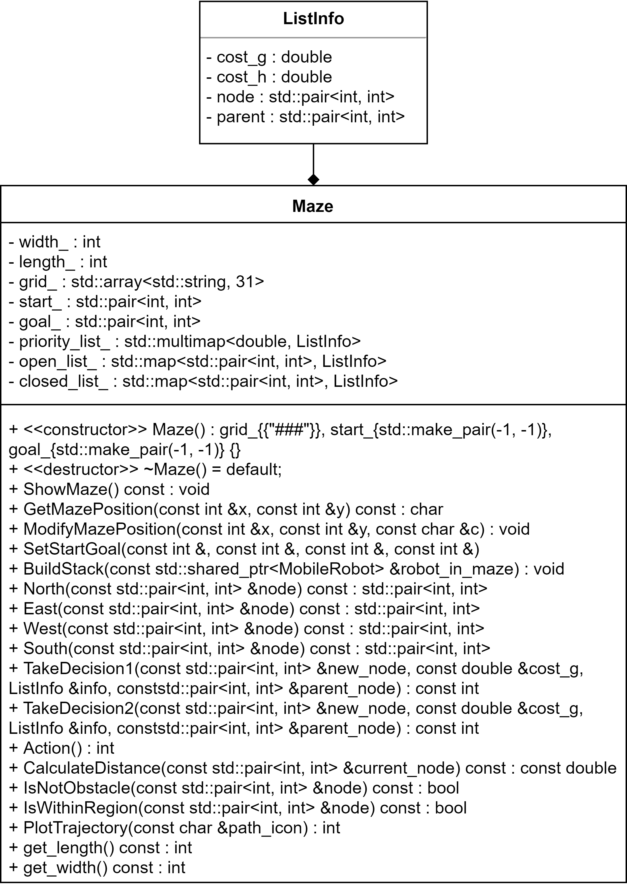

Maze.h
Contributor: Arun Kumar Devarajulu
Maze Class (A* Algorithm)
Maze Class the core class that executes the searching algorithm and solve for the maze. Just like agent Smith in Matrix, it can do its core job on its own. And even more alike, we actually create three Maze objects in the program to do similar jobs, but independently.
Image from https://www.youtube.com/watch?v=g70WH9VJDUc
Notes:
C++ classes

Slide 7
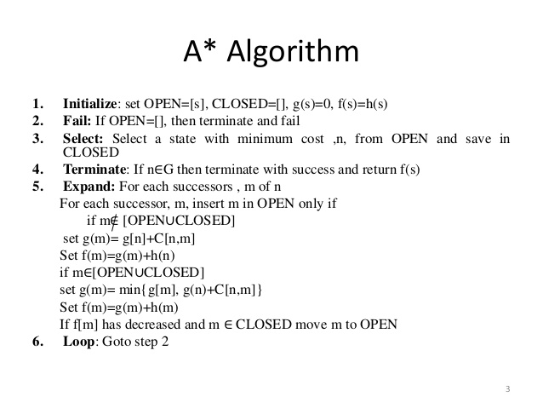
A* Algorithm
Maze.h
Notes:
Talk about the A* you implemented and how it is integrated in the project (using diagrams for instance)

Slide 8
Maze.h
Contributor: Arun Kumar Devarajulu
Algorithm Brief
The Maze class contains the search based A* navigation algorithm for solving our path finding problem. The algorithm accepts a start position and goal position and finds a shortest path. The average complexity of our algorithm is O(log n) because we use only one for loop to iterate through few entries (two or three out of ~70) of priority list_ during rare instances. The algorithm finds the shortest path very quick.
Notes:
C++ classes

Slide 9
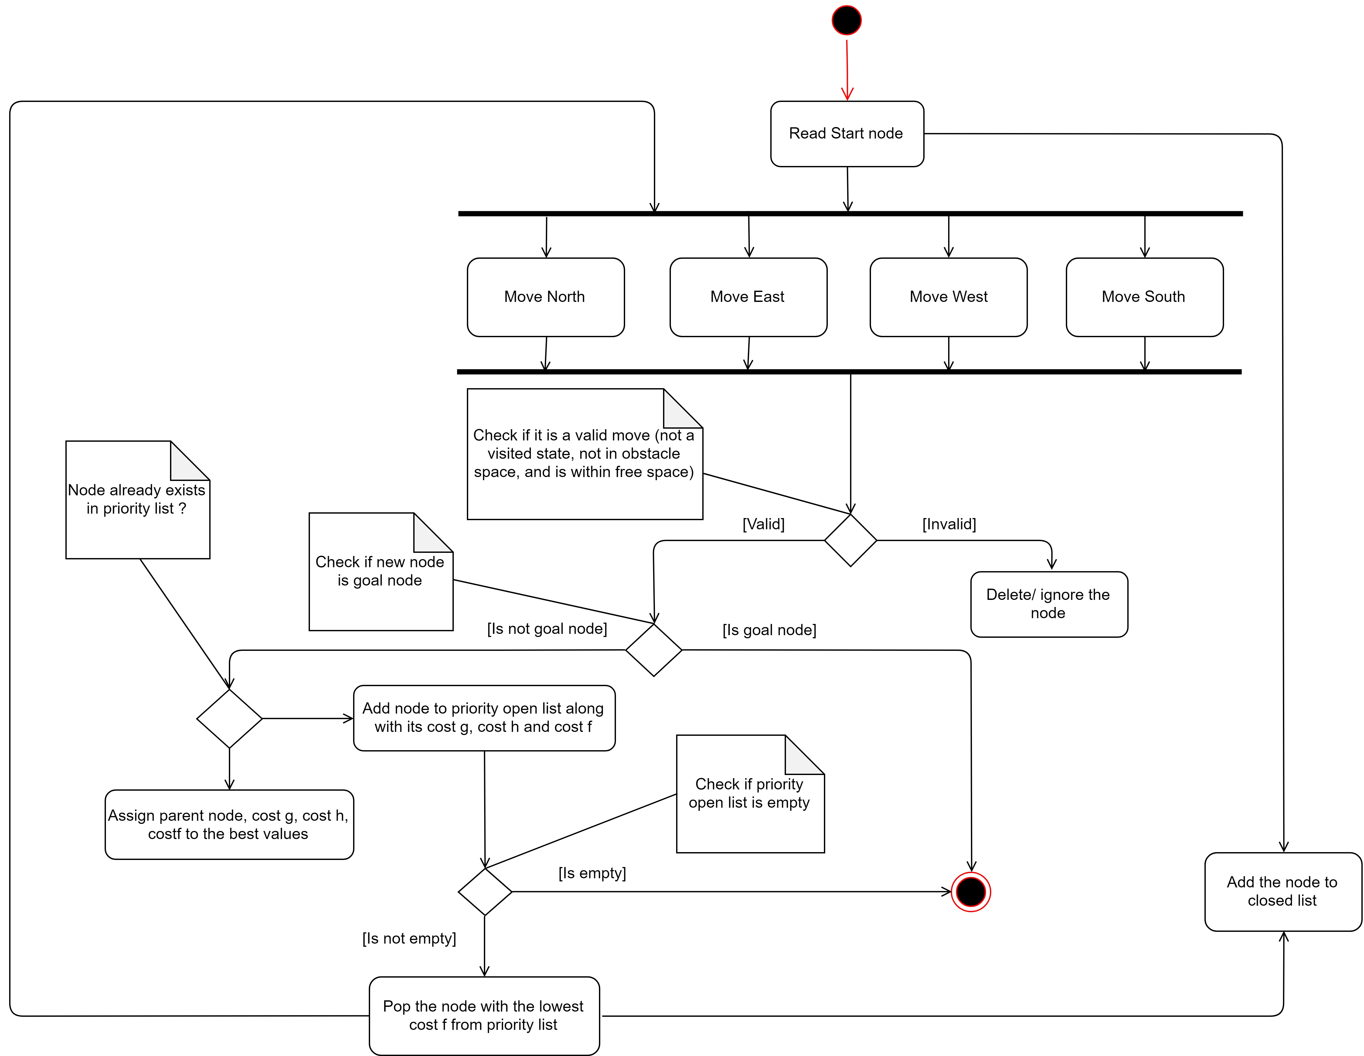
Maze.h
Contributor: Arun Kumar Devarajulu
A* Algorithm Activity Diagram
Notes:
C++ classes

Slide 10

Maze.h
Contributor: Arun Kumar Devarajulu
Algorithm Brief
A-Star searching area.
Figure from Zuyang Cao
Notes:
C++ classes

Slide 11
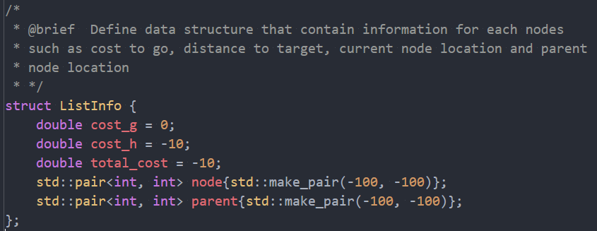
Maze.h
Contributor: Arun Kumar Devarajulu
ListInfo
The struct ListInfo is an essential part of the A* algorithm. It is used for storing all the information needed for each node during A* algorithm path-finding procedure
Notes:
C++ classes

Slide 12
Maze.cpp
Contributor: Arun Kumar Devarajulu
CalculateDistance
Compute heuristic cost, here we use euclidean distance.
Notes:
C++ classes

Slide 13
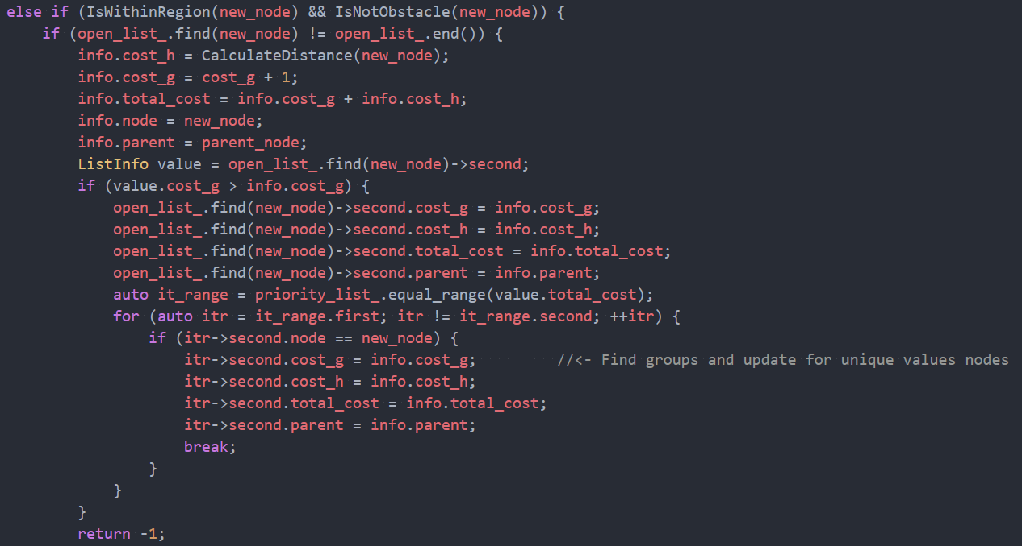
Maze.cpp
Contributor: Arun Kumar Devarajulu
TakeDecision
Function to check whether the current cost f is better than previous cost f
Notes:
C++ classes

Slide 14
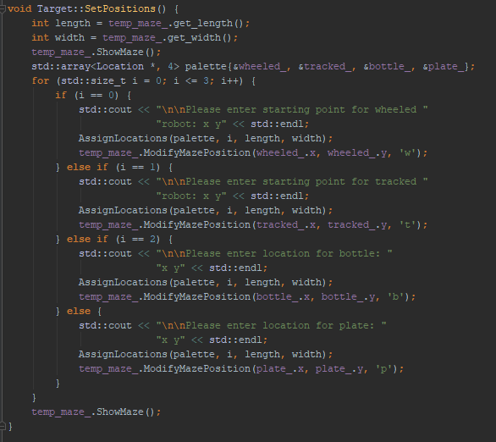
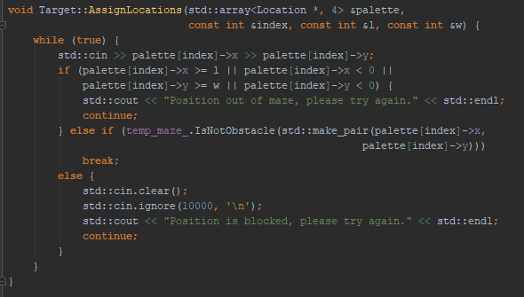
Target.cpp
Contributor: Zuyang Cao
SetPositions
Gets initial position for the wheeled robot, use IsNotObstacle function to determine if the position is blocked. The procedure is similar for tracked robot and targets.
Notes:
C++ classes

Slide 15
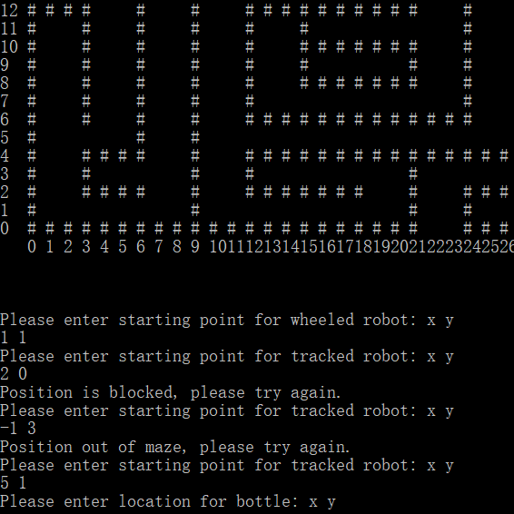
Contributor: Zuyang Cao
SetPositions (Demo)
The prompt will show whether the position is valid for a target, if not, it will ask again.
Notes:
C++ classes

Slide 16
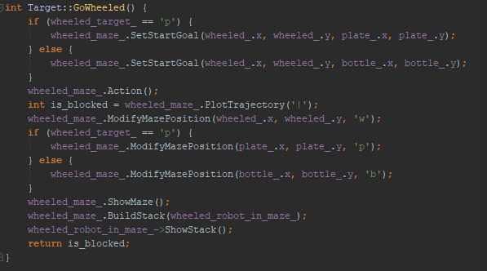
Target.cpp
Contributor: Zuyang Cao
GoWheeled
First determine the target for the wheeled robot and use maze object method to solve for the path. Then build the stack inside the wheeled Robot object to realize the pushdown automata. Finally it prints the states the robot took.
Notes:
C++ classes

Slide 17
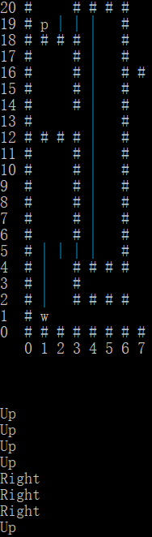
Target.cpp
Contributor: Zuyang Cao
GoWheeled (demo)
GoWheeled function will first show the maze and path only for the wheeled robot. Then it will use pushdown automata to give the step states for the robot object.
Notes:
C++ classes

Slide 18
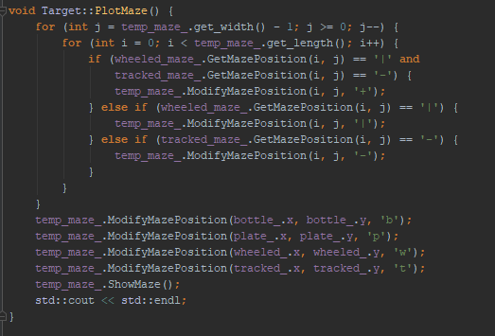
Target.cpp
Contributor: Zuyang Cao
PlotMaze
In the tempMaze object, the two paths will be combined. In order to prevent the robots and targets from being covered by paths, the characters are defined again.
Notes:
C++ classes

Slide 19
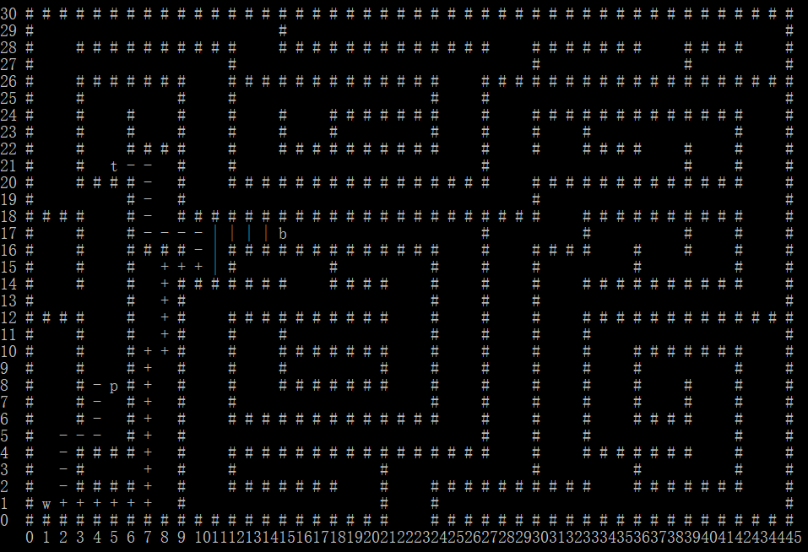
Contributor: Zuyang Cao
PlotMaze (demo)
Final output for both paths
Notes:
C++ classes

Slide 20
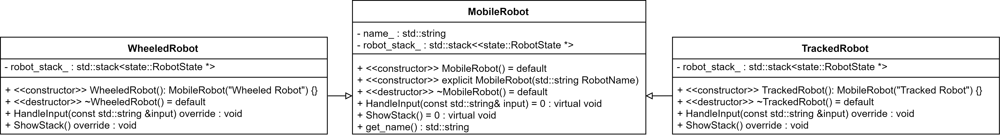
Mobile Robot and FSM classes
Contributor: Qidi Xu
MobileRobot class hierarchy structure
Notes:
C++ classes

Slide 21
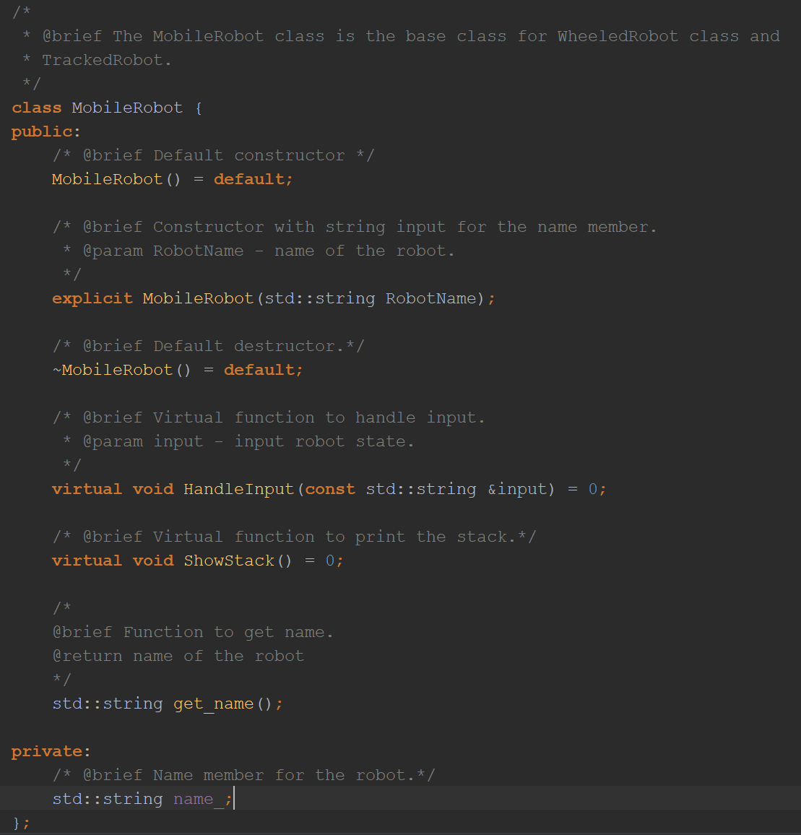
Mobile Robot and FSM classes
MobileRobot.h
Contributor: Qidi Xu
Mobile Robot class is defined as shown.
Notes:
C++ classes

Slide 22
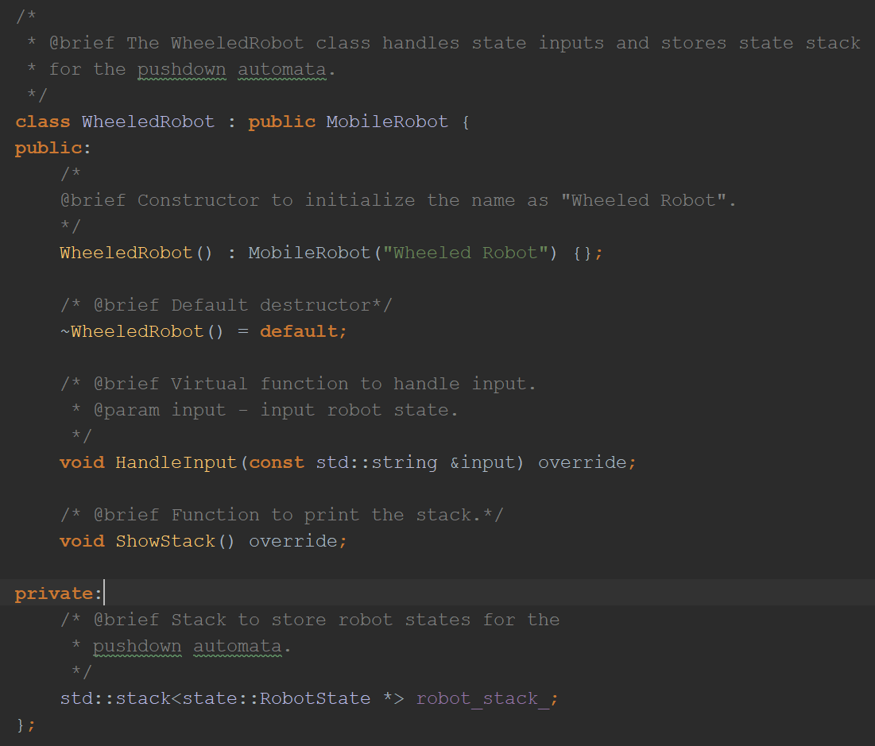
Mobile Robot and FSM classes
Contributor: Qidi Xu
WheeledRobot class and TrackedRobot class are derived from MobileRobot.
Both of them will contain the HandleInput method and RobotStack_ member from MobileRobot class
Notes:
C++ classes

Slide 23
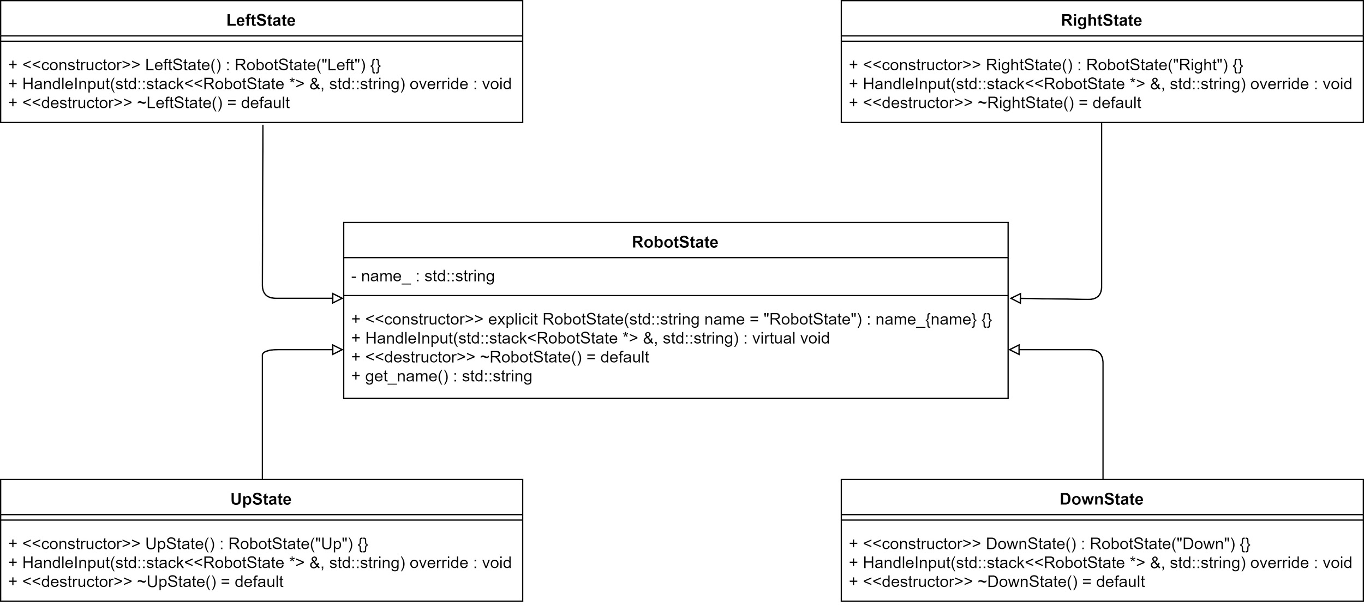
Mobile Robot and FSM classes
Contributor: Hongyang Jiang
Notes:
C++ classes

Slide 24
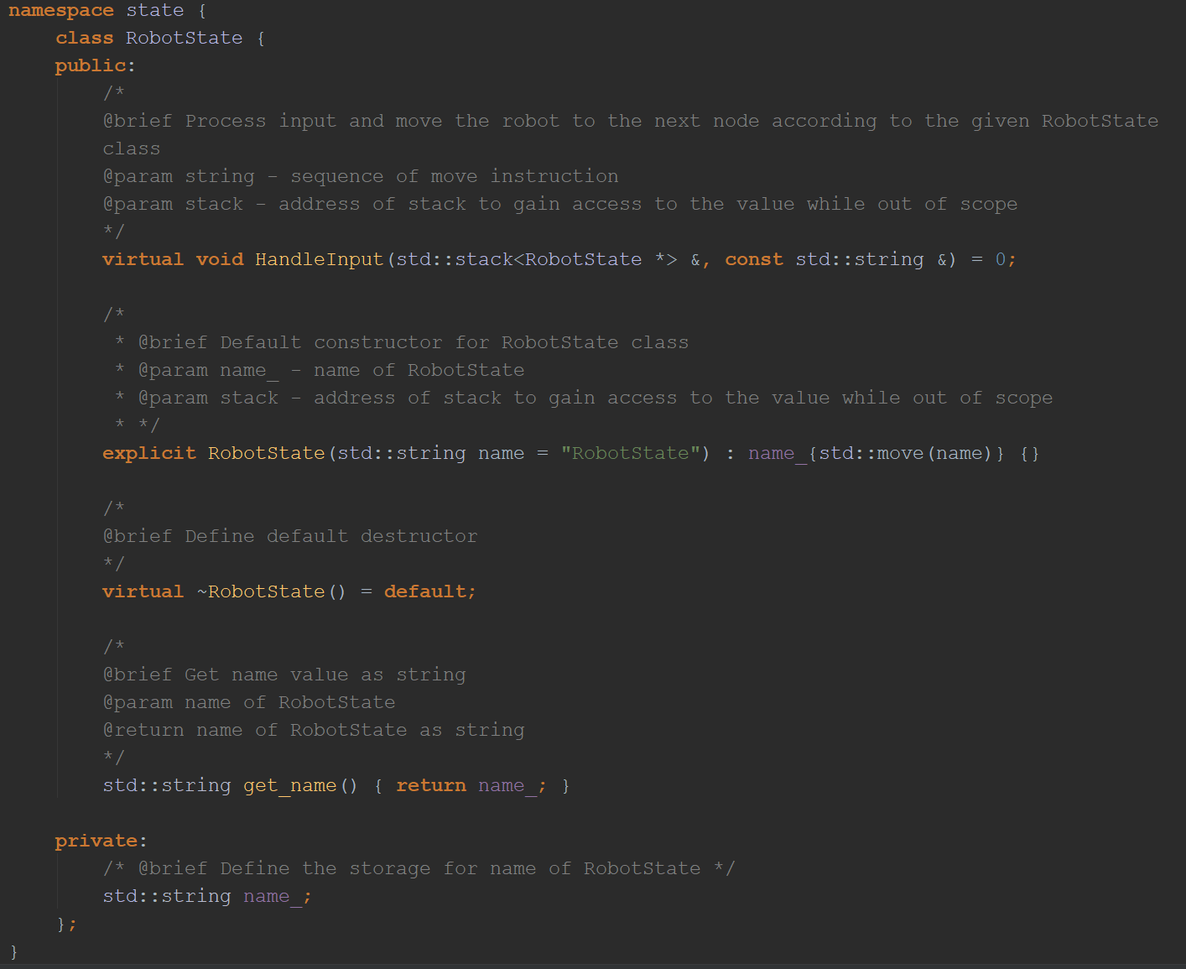
Mobile Robot and FSM classes
RobotState.h
Contributor: Hongyang Jiang
RobotState only contains one private member name_ which will be accessed through public method get_name
Notes:
C++ classes

Slide 25
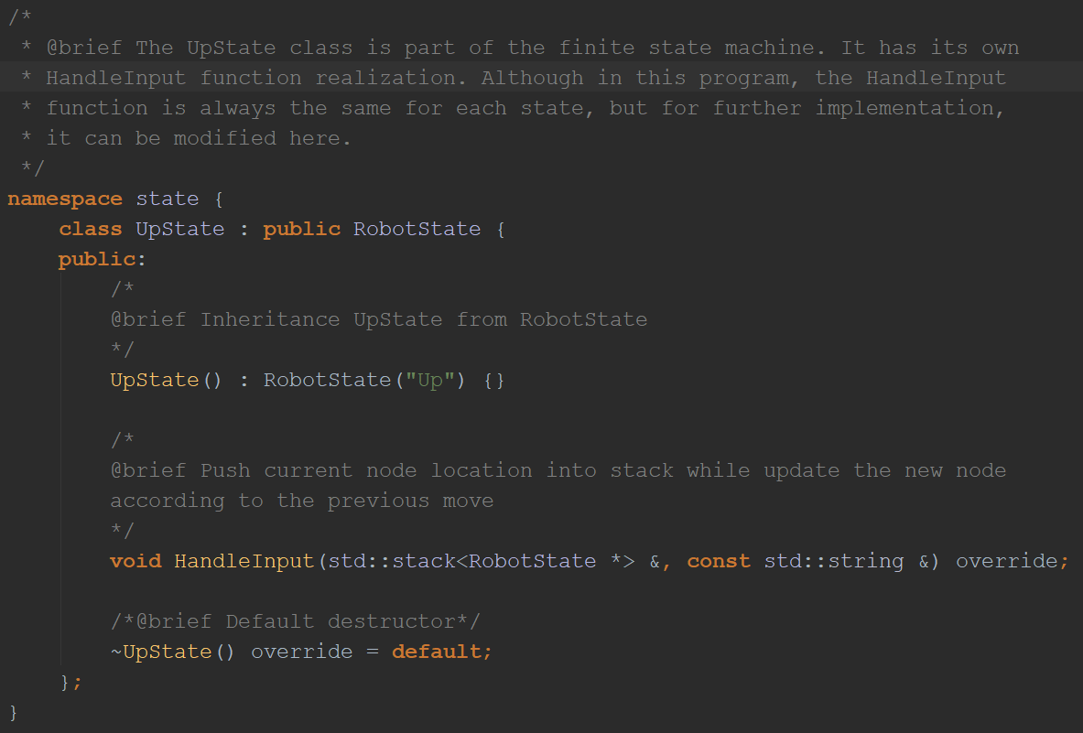
Mobile Robot and FSM classes
UpState.h
Contributor: Hongyang Jiang
Other classes such as UpState, DownState, LeftState and RightState are derived from base class RobotState.
Notes:
C++ classes

Slide 26
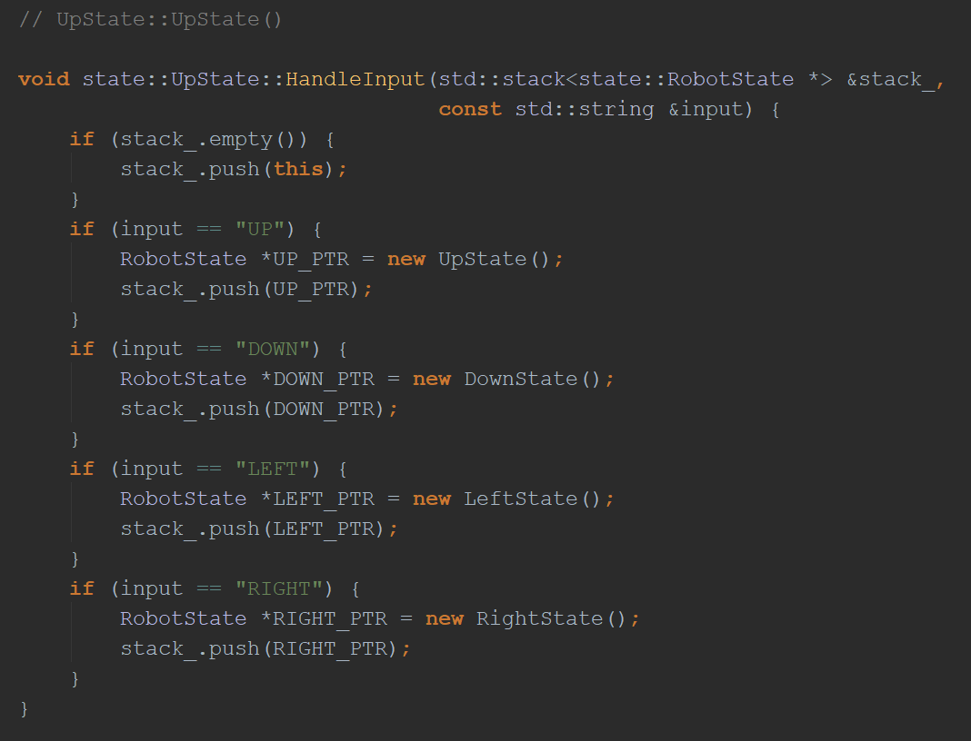
Mobile Robot and FSM classes
MobileRobot_FSM.cpp
Contributor: Hongyang Jiang
The HandleInput member function of each derived class will govern the next step of robot based on the current state.
For example, if the current state is Up, then the next state won’t be Down.
Notes:
C++ classes

Slide 27
Mobile Robot and FSM classes
MobileRobot_FSM.cpp
Contributor: Hongyang Jiang
However, since we employed the A* algorithm for navigation, we knew the robot won’t turn around.
Thus we defined the method as such.
Notes:
C++ classes

Slide 28
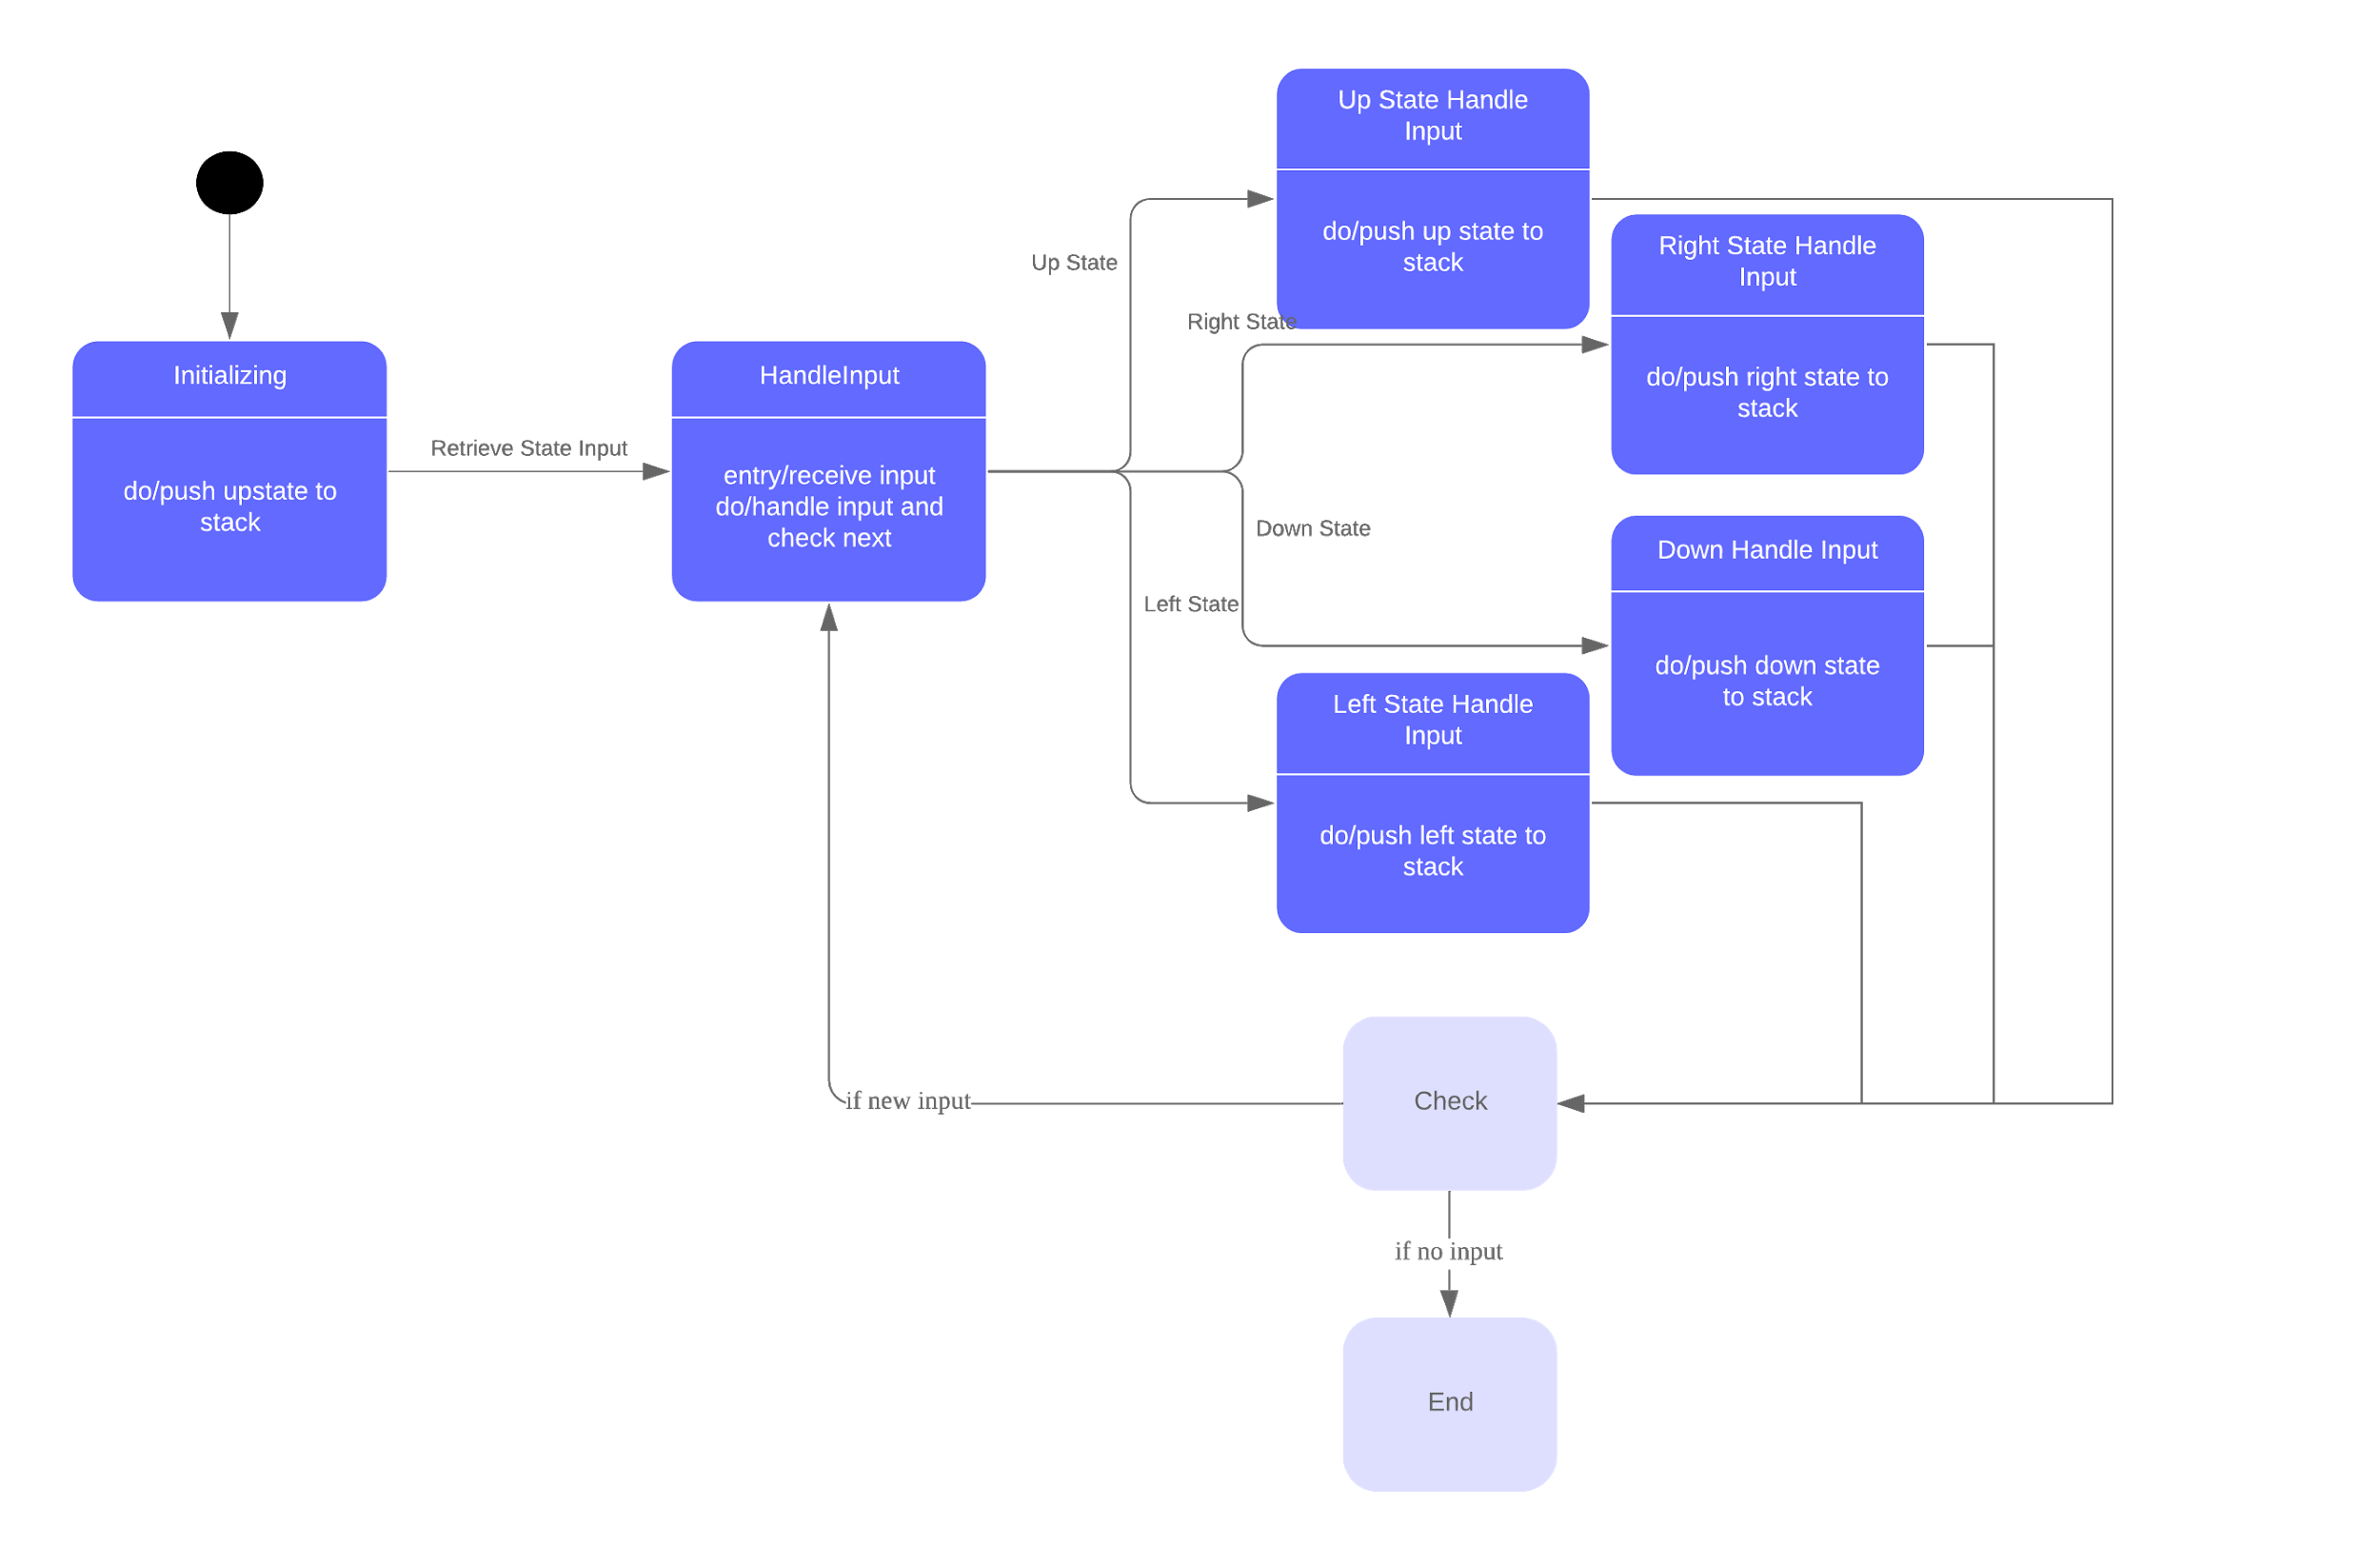
MobileRobot_FSM.h
Contributor: Qidi Xu, Hongyang Jiang
Handle Input Structure
Robot class has a handle input function to take in state inputs and find corresponding states.
Robot State class has a handle input function to push to stack.
Notes:
C++ classes

Slide 29
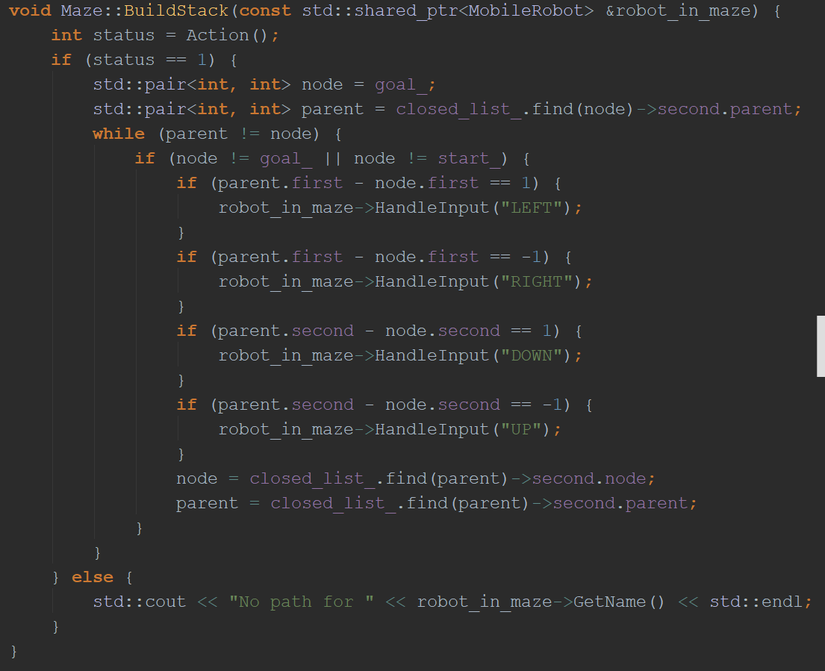
Maze.cpp
Contributor: Zuyang Cao
BuildStack
From nodeInfo the path can be found in a reversed order. Push the corresponding states to the state stack so that it will pop the path in a correct order.
Notes:
C++ classes

Slide 30

Google Style Guide check
Contributors: Qidi Xu and Arun Kumar Devarajulu
We followed the coding conventions as specified by Google style guide
All function and class names start with Upper case for every new word
Example : class RobotState, void ShowMaze()
All accessors and mutators are named like variables
Example : int get_length()
All variables are named in lower case
Example : robot_stack_

Slide 31

Concepts Applied
Object-oriented programming
Inheritance
Polymorphism
Finite state machine
A* Algorithm
Raw pointers
Smart pointers
UML Diagrams (Class and Activity)
Doxygen documentation
Google style guide
CMake build
C++ 11 and 14 standards

Slide 32
Contributions
Arun Kumar Devarajulu: A-Star Algorithm, Maze Class, Debugging, Optimization
Zuyang Cao: Target Class, Stack Building, Overall Combining, Debugging
Qidi Xu: Mobile Robot Class, TrackedRobot Class, WheeledRobot Class
Hongyang Jiang: Robot State Class, Up, Down, Right, Left State Classes
Notes:
C++ classes

